Slide 1
354ILC - How to test migrated data
June 1, 2021
Chaim Elbaum, PS

Slide 2
How to test migrated data
Introduction
Staff User Setup
Libraries and Locations
Bib Records
Holdings
Items
Electronic resources
Acquisitions
Inventory Reports
Patron Records
Fulfillment Configurations
Analytics

Slide 3
Introduction

Slide 4
Purpose of Data Checking
Look for errors - is the data in the right place?
Record counts - do the numbers make sense?
Did e-resources migrate correctly? Did everything make it through the P2E process, that should have?
Did the link resolver data migrate correctly? Did you get the expected number of packages and portfolios?
Involve relevant staff for different areas of data checking
Identify changes to the Migration form and the validation mapping - note what needs to be changed, if anything
Identify cleanup tasks

Slide 5
Dealing with Issues
Did you find something suspicious?
Verify by finding several other examples
Verify by finding a pattern
Gather examples - 2-3 at least
Can you tell how the issue was created?
Report to Ex Libris
Report via Basecamp
Include steps used to find the problem/issue
Include examples - make sure to include record numbers where relevant
If needed, EXL staff will request the issue be reported via Salesforce case for further investigation
Identify changes for next migration cycle
Is the issue linked to the mapping or the migration form? If so, inform EXL staff
Both sides will keep list of things to change at next migration cycle
If in doubt about an issue, ASK!

Slide 6
Staff User Setup

Slide 7
Staff User Roles
Add Roles so staff can perform relevant testing
See "Descriptions & Accessible Components" at User Management for detailed information about what each role has access to.
Some roles are institution level only, and some are set at library or institution level
Some roles MUST have a Service Unit (e.g. a circ desk or a department)

Slide 8
Staff Roles and Service Units
Library Level Roles - required service unit
Circulation Desk Manager/Operator/Operator Limited - Circulation Desk
Requests Operator - Circulation Desk
Receiving Operator/Operator Limited - Acquisitions Department
Work Order Operator - Work Order Department (NB: acquisition departments not listed here, as those are handled with the Receiving roles)

Slide 9
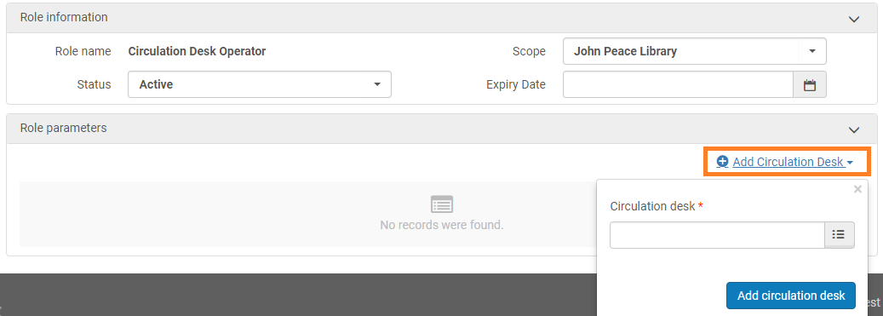
Staff Roles-Scopes and Parameters
Manage Users
Select relevant location at sign-in
Specific library scope, with a specific service unit.

Slide 10
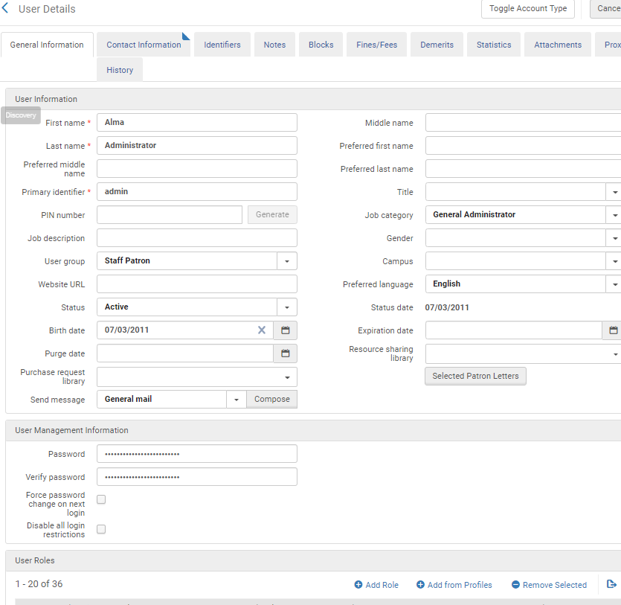
Preparing to Test Data - Staff User Set-up
Set up your staff users:
"Toggle Account Type" on migrated user records - add a password - login is the primary identifier
When authentication is set up, user records can be toggled back to external

Slide 11
Preparing to Test Data - Staff User Set-up (cont.)
Institution level roles - once added, will be grayed out in the “Add Role” menu.
*Minimum required roles to test migrated data
User Administrator
*User Manager
Acquisitions Administrator
Fiscal Period Manager
*Fund-Ledger Viewer
*License Manager
Purchasing Operator Extended
Selector/Extended
*Usage Data Operator
Fulfillment Administrator
Electronic Inventory Operator
Catalog Administrator
Catalog Manager
*Cataloger
Cataloger Extended
API Analytics (all roles)
*Design Analytics
General System Administrator
Letter Administrator
SDK Write

Slide 12
Preparing to Test Data - Staff User Set-up (cont.)
Institutional and/or library level roles
Fund Manager
Ledger Manager
*Invoice Manager/Operator/Extended
*Purchasing Manager/Operator
*Vendor Manager
*Course Reserves Manager/Operator
Instructor
*Patron
Resource Sharing Partners Manager
Collection Inventory Operator/Extended
Digital Inventory Operator/Extended
*Electronic Inventory Operator /Extended
*Physical Inventory Operator/Extended
*Repository Administrator/Manager
Work Order Operator (Requires a service level)

Slide 13
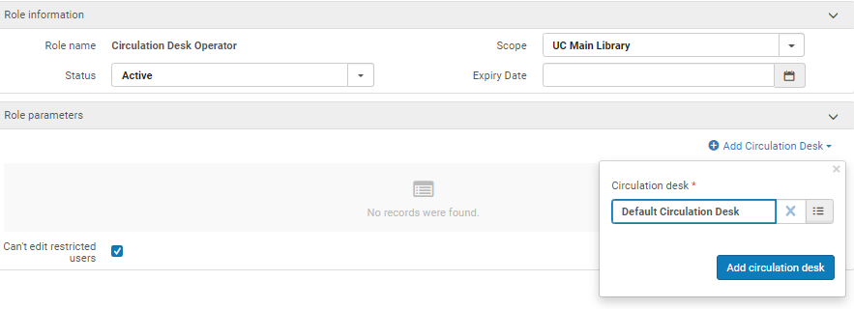
Preparing to Test Data - Staff User Set-up (cont.)
Library Level Roles - require a service unit:
Circulation Desk Manager (Service Unit = A Circulation Desk)
*Circulation Desk Operator (Service Unit = A Circulation Desk)
Circulation Desk Operator – Limited (Service Unit = A Circulation Desk)
*Requests Operator (Service Unit = A Circulation Desk)
*Receiving Operator (Service Unit = An Acquisitions Department)
Receiving Operator - Limited (Service Unit = An Acquisitions Department)
Fulfillment Services Manager (Service Unit = A Course Reserves Department)
Fulfillment Services Operator (Service Unit = A Course Reserves Department)
Work Order Operator (Service Unit = A Work Order Department or Acq department

Slide 14
Minimum Roles needed to test migrated data (summarized)
Circulation Desk Operator (Service Unit = A Circulation Desk)
Requests Operator (Service Unit = A Circulation Desk)
Receiving Operator (Service Unit = An Acquisitions Department)
Cataloger
Design Analytics
Electronic Inventory Operator
Fund-Ledger Viewer
Invoice Operator
License Manager
Patron
Physical Inventory Operator
Purchasing Operator
Repository Manager
Usage Data Operator
User Manager
Vendor Manager
Additional roles are needed to test configurations and other functional features

Slide 15
Libraries and Locations

Slide 16
Libraries and Locations
Verify Library and Location information is correct for each library
Configuration > “Configuring” > Choose library
Configuration > Fulfillment > Libraries
Click on “Library Details” - check contact info and calendar
Note: for an overview, click “Add Widget” on home screen and add “Organization Calendar”
Click on “Physical Locations” - verify all locations are present; verify correct Fulfillment Unit and Circulation Desk assigned

Slide 17
Bib Records

Slide 18
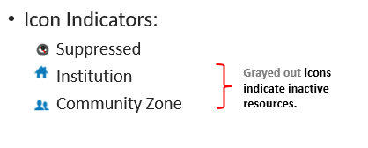
Bibs - Search Basics Review
Tools to use:
Facets on left of the display
Change “Find” (see difference between physical, electronic, titles, items)
Remember there are no stop words (a, an, the, etc. are all valid terms)
Record count in upper left - are the numbers expected?
Links to requests or orders (if migrated)
D
D
D
D
D
Network Zone

Slide 19
Bibs - Search Basics Review (cont.)
Save Query
Used to create a set
Sets keep the results of your search for later use
Can import sets using Excel files or Analytics queries
Can export to Excel to create reports for cleanup
Tip: for large results, break down into smaller sets before exporting
Explanation of Facets, Icons, Search Criteria, etc.
Glossary of Alma Terms

Slide 20
Bibs
Search “*” in All Titles - check record count
Standalone Bibs
“All Titles”; Has inventory = No
Undefined Resource Type
“All Titles”; Resource Type = Undefined
Resource Type is calculated based on the LDR & 008 values
Material Types migrated correctly
“All Titles”; Material Type = (select types from dropdown)

Slide 21
Bibs
Suppressed records
“All Titles”; “Tag Suppressed (Title)” = Yes
For more information, see Online Help:
Search Indexes
MARC 21 Bibliographic Tag to Search Index Mapping table
MARC 21 Holding Tag to Search Index Mapping table
Sections on searchable fields for:
Electronic Collections
Electronic Portfolios
Holdings
Physical items

Slide 22
Holdings

Slide 23
Holdings
Number of Holdings:
“Physical Titles”; keyword “*”
Per Lib/Loc: Advanced Search; “Physical Titles”; Permanent physical location
Empty Holdings Records
“Physical Titles”; “Has Items” = No
Call Number Problems
“Physical Titles”; permanent call number” <= 0; Permanent call number type
Bibs that were left off of the P2E
“Physical Titles” where Permanent physical location = [Internet/ONLINE/ELECTRONIC locations]
Holdings in an UNASSIGNED Location
Physical Titles where Permanent physical location = “UNASSIGNED”
“Save Query” to access these sets later via “Manage Sets”

Slide 24
Items

Slide 25
Items
Search “*” in Physical Items
Items without a valid permanent location
“Physical Items”; “Permanent physical location” is empty
Enumeration / Chronology migration
Physical Items “Item Description” contains keywords “*”
Items on Hold Shelf
Physical Items; Process Type = Hold Shelf
Items on Loan
Physical Items Process Type = “Loan”; Check Loan Status and Due Date
“Lost” Items
Physical items Process Type = “Lost”

Slide 26
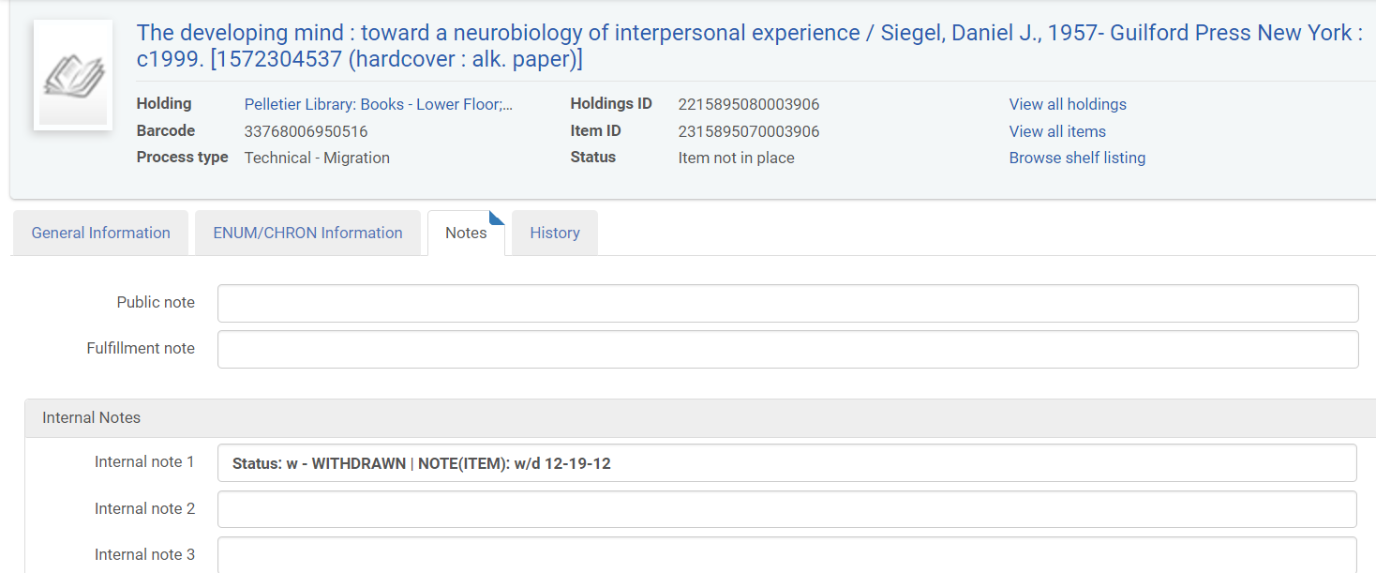
Items
Items with Technical Migration process status
Physical Items; “Process type” = Technical - Migration
Reasons for the status is noted in the Item’s “Notes” tab

Slide 27
Items
To clean up these records, there are 4 main workflows, depending on the status & desired result. You will first create a set of the items in question, and then “Run a Job”, with one of the following options:
Change the status from “Technical Migration” to “Missing” (Job = Change Physical Items; criteria: ‘missing’ = checked and ‘missing’ chosen in dropdown)
Remove the “Technical Migration” status in bulk (Job = Change Physical Items; criteria: ‘missing’ = checked & dropdown blank)
Bulk withdraw items (Job = Withdraw Items)
Create a work order for the item (Job = Create Physical Item Work Orders)

Slide 28
Electronic Resources

Slide 29
Electronic Resources
Electronic Collections or Electronic Portfolios searches
Local (created by P2E process)
Linked to the Community Zone (created from link resolver)

Slide 30
Electronic Resources - P2E
Number of P2E records
Electronic portfolios - Is Standalone = Yes
Note: For each bib provided in the P2E file, a portfolio is created for each 856 link. If a bib had multiple 856 links, there will be a portfolio created for each so the number of portfolios should exceed the number of bibs in the P2E file.
Broken Links
Electronic Portfolio - URL “Is Empty”
Note: You can use the “Export URLs” job to create a file of all URLs in your P2E portfolios (this can be helpful for cleanup/identifying duplicates)

Slide 31
Electronic Resources - Link Resolver
Number of Portfolios (all portfolios will be in a collection)
Electronic portfolios - Is Standalone = No
Electronic portfolios - Is Local = No
(depending if local portfolios have been migrated from link resolver)
Number of Packages
Electronic Collection WHERE electronic collection type = Database/Aggregator/Selective
Packages are available?
Electronic collection availability = “Not Available”

Slide 32
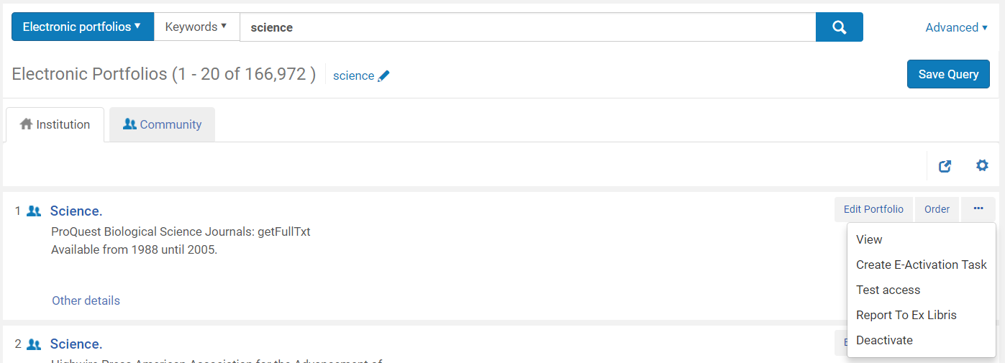
Electronic Resources - Test access
Verify access to electronic resources
Advanced Search: “electronic portfolios” where keyword contains “*”
On any portfolio, click “test access”
You should be directed to e.g. the resource

Slide 33
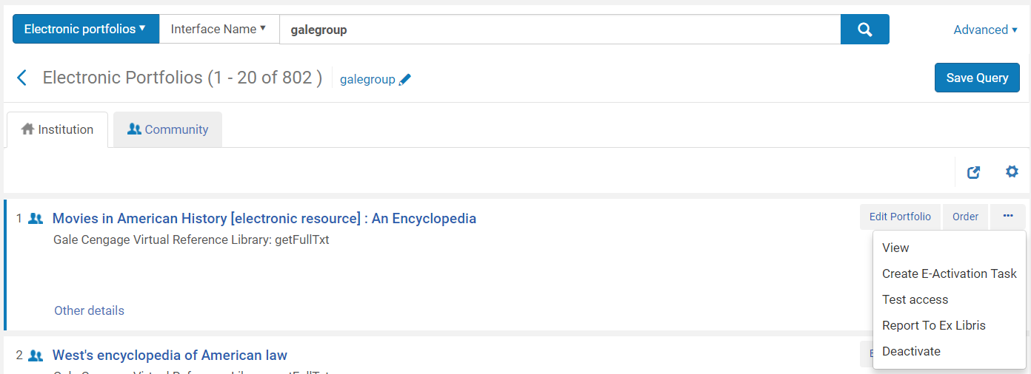
Electronic Resources - Linking Parameters
Check that linking parameters are correctly applied
Simple search: “Electronic portfolio” where “Electronic Collection: Electronic collection name” contains (e.g. Ebook Central Perpetual… - any collections with special linking parameters)
Click “Test Access”
You should be able to reach the resource

Slide 34
Acquisitions

Slide 35
Acquisitions
Purchase Order Lines in Review
Lists POLs with either data issues, alerts, or are in Review based on purchasing review rules
Purchase Order Review
Lists POs with invalid or missing mandatory information
Receive
Two tabs: One Time (one time orders) and Continuous (serials, subscriptions)
Lists orders that are waiting to be received
Invoicing Review and Approve
Lists invoices to be reviewed / to be approved
Receiving Department Items
Lists items that have been kept in department after receipt

Slide 36
Acquisitions
Waiting for Payment
Lists invoices that need to be paid or are waiting for payment confirmation from the ERP
Vendors
All migrate as “Material Supplier” - can be “Access Provider” (provides e-resource interfaces) or “Licensor” (holder of e-resource license)
Funds and Ledgers
Facets allow you to group/focus the funds, view by ledger, view by summary funds
Search for Order lines
Allows you to search POLs if you don’t have the POL number

Slide 37
Inventory Reports

Slide 38
Inventory Reports
Overlap Analysis
Two Options:
Existing collections, to see which overlapping titles are included in each set
Selected titles (for example, a list of titles in a collection under review) against the current electronic titles
Options:
Match method
Ignore/consider date coverage
Results:
Overlapping titles
Unique titles
For more information: Working with Overlap and Collection Analysis

Slide 39
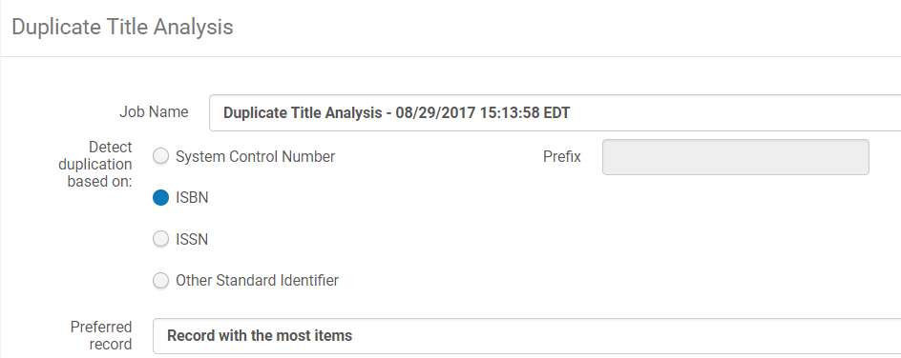
Inventory Reports
Duplicate Analysis
creates report identifying duplicate bib records
Can match on:
system control number (035 - with or without prefix)
ISBN
ISSN
Other standard identifier (024)
For more information: Using Duplicate Title Analysis

Slide 40
Patron Records

Slide 41
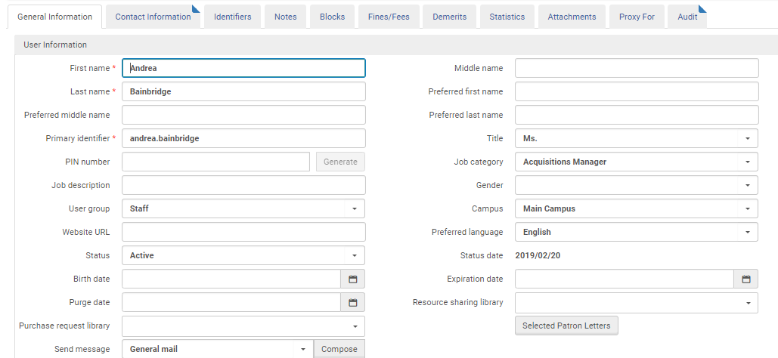
Checking Patron Records
Manage Users - things to look for:
Patrons with loans, overdue/lost items, active fines/fees
User group assigned properly
Contact information (address, phone, email)
Statistical categories
*Note: Migration inserts “_SCRUBBED” into every email address
(not yet relevant for SLSP b/c of anonymization)
D
D
D

Slide 42
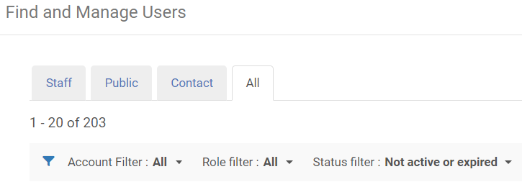
Checking Patron Records
Manage Users
Expired/inactive
Note: You can “Run a Job” to bulk change expiration dates, if necessary
Manage Sets >> Add a Set (Logical) >> Set content type = User
Run a job >> Update/Notify Users

Slide 43
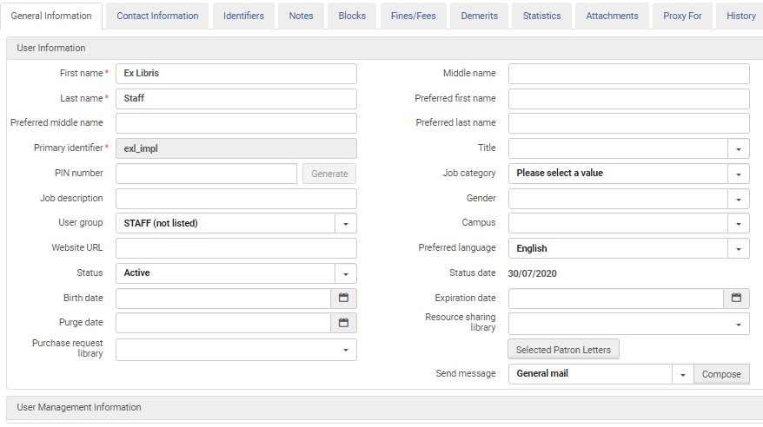
Checking Patron Records
You can only spot check the patron records in Alma; for patrons with loans, overdue/lost items, active fines/fees, checking if user group assigned properly

Slide 44
Fulfillment Configuration

Slide 45
Fulfillment Configuration
Test your fulfillment policies:
Gather a list of barcodes that should circulate a certain way for certain types of users
Gather a list of patron barcodes that represent your user groups
Use the Fulfillment Configuration Utility to check that the correct values are being applied for barcode/patron combinations. In particular, check:
Loanable
Due Date
Lost Item Fine/Replacement Fee
Maximum Fine
Overdue Fine
Is Renewable
Maximum Renewal Period
Closed Library Due Date Management

Slide 46
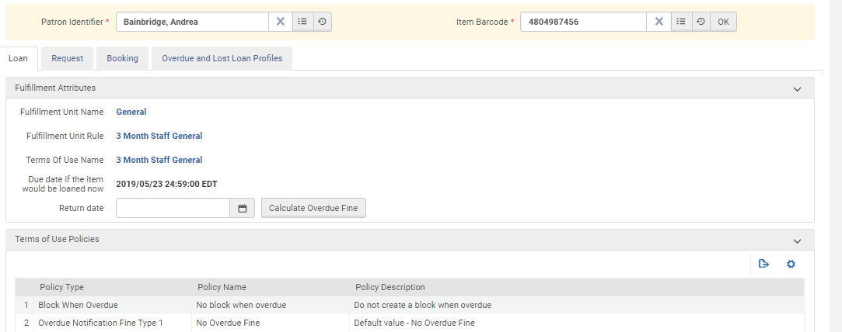
Fulfillment Configuration Utility
Policy “containers”
Specific policies involved

Slide 47
Analytics

Slide 48
Analytics
See ExLibris Knowledge Center/Alma under:
Alma > Training > Analytics> (recordings)
Introduction to Analytics – About Analytics, Accessing & Navigating (5-6 min)
Reports and Dashboards - How to run out-of-the-box reports, edit and create reports, and configure My Dashboard (20-23 min)
Providing Reports to Other Users - how to share reports and dashboards ; create sets in Alma to use in Analytics (10-12 min)
Alma > Training > Extended Training > Presentations & Documents – Analytics
Many “how to” presentations/documents on a variety of topics – teaches you how to work Analytics
Analytics can do record counts and help you find data in fulfillment, course reserves, physical items, titles, usage data and more – get in there, explore & experiment

Slide 49
Analytics
In Alma See :
Analytics > Reports > Data Review Dashboard (or Test Load Reports Dashboard)
Creates basic statistics on migrated data
Count of Physical items by locations –click on any location to see next level of detail for all locations – this may take a while to retrieve
Count of Users by Group
Click on Group to see next level of details for all users
Available to “General Administrator” role
May need to make available to other roles such as Cataloger or Repository Administrator

Slide 50
Documentation
More details can be found in
Testing Resource Management Data Migration to Alma
Testing Fulfillment Data Migration to Alma
Testing Acquisitions Data Migration to Alma

Slide 51
Thank you!
Chaim.Elbaum@exlibrisgroup.com

