Slide 1
Stefnumót við Libby

Slide 2
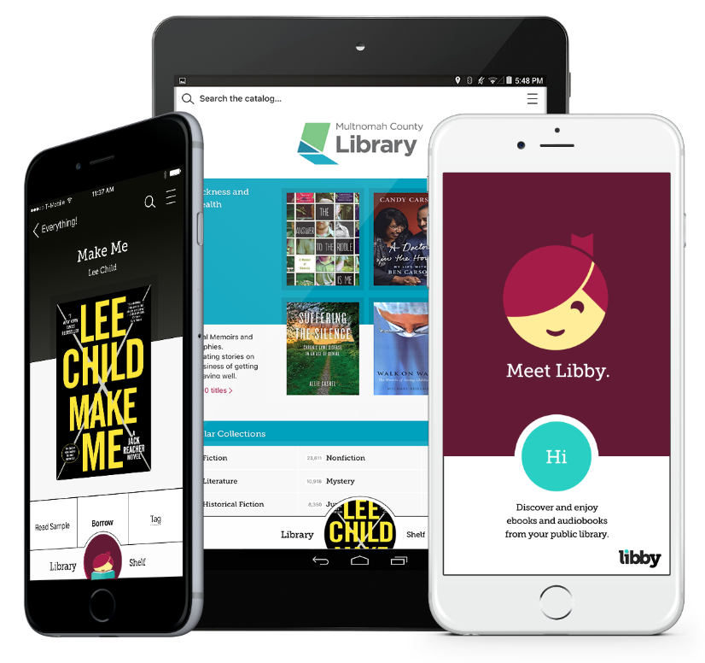
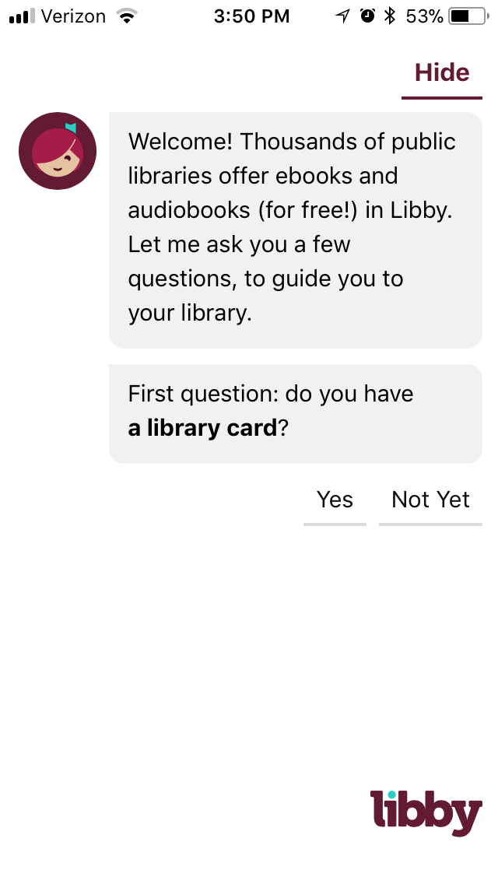
Byrja
Með Libby, getur þú vafrað í Rafbókasafninu, tekið að láni og notið raf- og hljóðbóka.
Þú þarft bara:
Nettengingu
Bókasafnskort
Tæki sem gengur
iOS
Android
Windows 10+
Notes:
Libby is a free, one-tap reading app that allows you to instantly borrow eBooks and audiobooks.
Getting started is easy; you just need an internet connection, your library login information, and a mobile device. Libby is free to install on iOS, Android, and Microsoft (10+) devices.
OverDrive is also working to make Libby available on Amazon Fire devices through the Amazon App store.

Slide 3
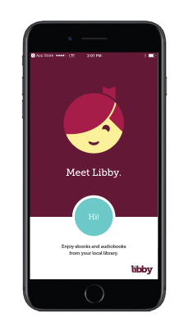
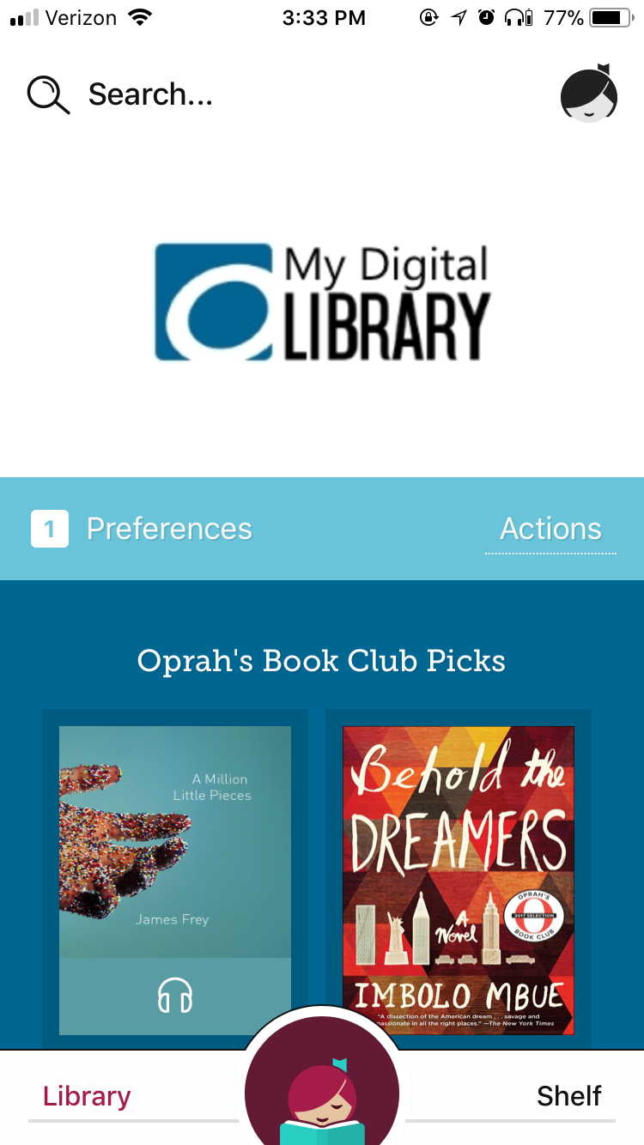
Ein snerting
Hverjir ættu að nota Libby?
Notendur sem eru að kynnast raf- og hljóðbókum.
Vanir notendur sem vilja nýjungar.
Hvað er það sem gerir Libby flotta?
Eina sem þú þarft er gilt bókasafnskort!
Ein snerting og þú ert komin/-n inn í Rafbókasafnið.
Af hverju var Libby búin til?
Hönnuð fyrir almenningsbókasöfn.
Hugsuð frá grunni með þarfir notenda í huga.
Notes:
Libby is great for users new to eBooks and audiobooks, as well as users familiar with the OverDrive app who want to try a fresh experience.
Why should you try it?
Libby was built to get you reading as quickly and seamlessly as possible. To accomplish this, Libby was created from the ground up with user feedback in mind.
You can now access thousands of books instantly, for free, with your library card.

Slide 4
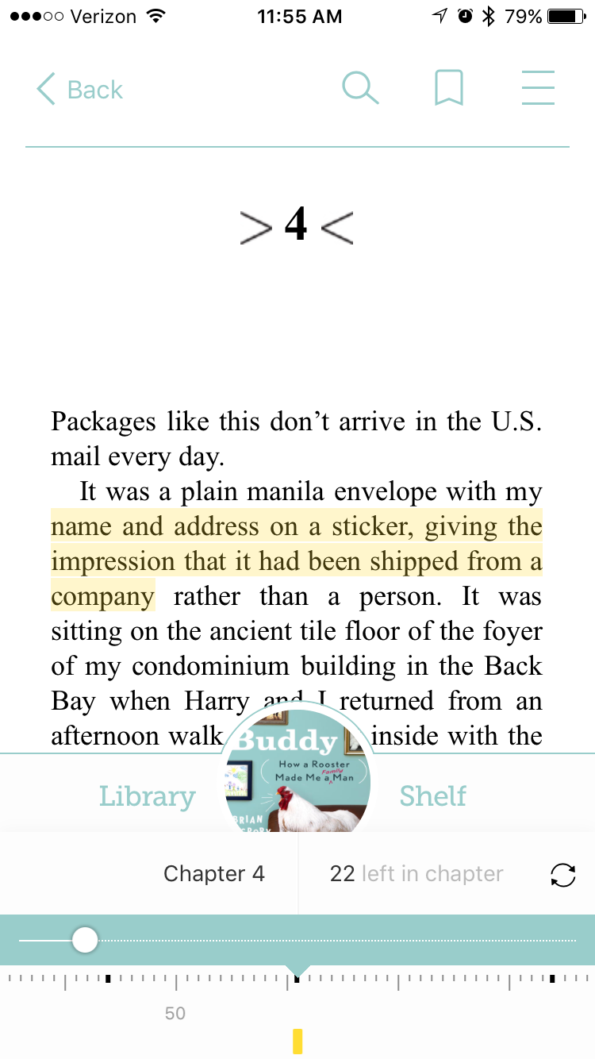
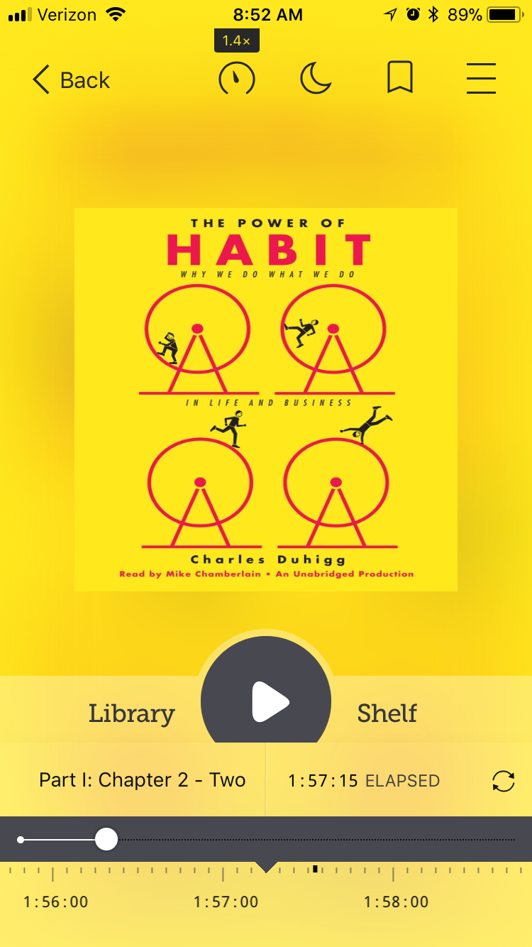
Niðurhal á bókum
Opnaðu rafbækur og hljóðbækur í Libby.
Stilltu appið fyrir lestur og hlustun.
Skoðaðu og “sync-aðu”.
“Brjóttu upp á horn á blaðsíðu”, gultússaðu og skrifaðu athugasemdir.
Sjáðu um útlánin í hillunni þinni.
OverDrive Read
OverDrive Listen
Notes:
Once you find a book you’d like, tap Borrow and open it right in Libby. By default, your digital books download automatically when you’re connected to wi-fi, but you can also stream them to save space.
When you open an eBook or audiobook in Libby, you’re using OverDrive Read technology. This means you get access to great features like the ability to highlight passages, take notes, and sync your progress.
If you need to manage your downloaded titles, simply tap Shelf. From your Shelf you can manage your download settings, return titles, or send them to a Kindle. Tap Library to find something new to enjoy.

Slide 5
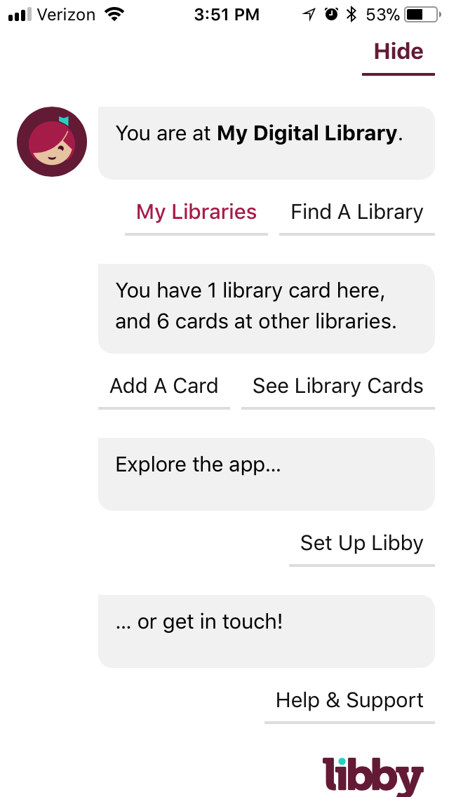
Stillingar í Libby
Tengdu Libby við Rafbókasafnið.
Settu inn númer á bókasafnskortinu.
Stilltu hvernig þú vilt vafra.
“Taggaðu” titla.
Sorteraðu og síaðu í leitum.
Stilltu niðurhal.
Veldu lestæki.
Tékkaðu allar frátektir.
Notes:
Libby also guides you to the best experience for your needs.
Prefer to read on a Kindle? She’ll help you send borrowed books to your Kindle.
Looking for titles to borrow right away? Set your Preferences to Available Titles.
Want to use Libby on more than once device? Set Up Libby to sync your library cards.

Slide 6
Notes:
Now I’m going to demonstrate how easy it is to borrow and enjoy eBooks and audiobooks with Libby, the one-tap reading app.
***See the “Meet Libby” demonstration checklist as a guide to walking patrons through this process.***

Slide 7
Hjálpin í Libby
Farðu á > Help & Support til þess að hafa samband við okkur.
Farðu í Libby hjálpina á vefnum, á FAQs & info og sjáðu hvernig Libby virkar.
Hafðu samband við OverDrive Support team ef vandamál koma upp.
Sendu okkur spurningar, hugmyndir þínar og segðu okkur hvað þér finnst.
https://help.libbyapp.com
Notes:
You can find Help & Support by tapping the Libby icon in the top right corner of the app.
From there you can submit your feedback about your experience to OverDrive and access help resources. The Libby Help website provides answers to many frequently asked questions. If you can’t find the help you need there, you can contact the OverDrive Support Team directly from within the app.

Slide 8
Næstu skref
1
Download the Libby app.
Find your library.
Enter your library card.
Enjoy!
Náðu í Libby appið.
2
Finndu bókasafnið þitt
3
Settu inn bókasafnskortið þitt.
Njóttu!
Notes:
The next step is to give Libby a try! If you haven’t already downloaded the app, search Libby in a compatible app store.
Thank you!

