Slide 1
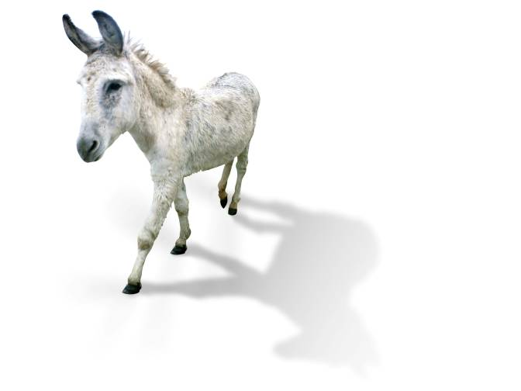
Pin the tail on the donkey
Notes:
A game of ‘Pin the tail on the donkey’ with a difference: flip chart with continuum of Family of works. Participants get cards with various expressions and works (“original, reprint, facsimile, translation, abridged edition, summary, parody, review, commentary etc.) and have to position them under “equivalent”, “derivative”, and “descriptive”. After all cards have been correctly placed [double-check with original graph!], draw cut off line beyond which a resource counts as a new work.
Esp. these decisions about what constitutes another expression or new work is down to individual cataloguer (or at least their organisation) who has to think about the particular needs of their users. E.g. rare books cataloguers might draw the line for a different expression or manifestation earlier (i.e. at the point of only a few differences), whereas a bestseller in a public library might be seen as one expression for a simultaneously published pbk/hbk edition or UK/US edition or even – if identical in content – all four of these together.
[Time for questions and discussion (15 mins?). Maybe taking a lead from particular problems with the correct placing of one/some of the card/s in the Pin game; otherwise – and esp. for an advanced audience – possible pointers are:
Suitability of FRBR for serials: whole serial = W, issue = E or M?, I = individual copy of issue; also: constitutes title change new work?
Aggregated works e.g. anthologies:
Hybrid works:
Unique material e.g. art works: WEMI obsolete? Because each copy of an art work would always be a new work in itself]

Slide 2
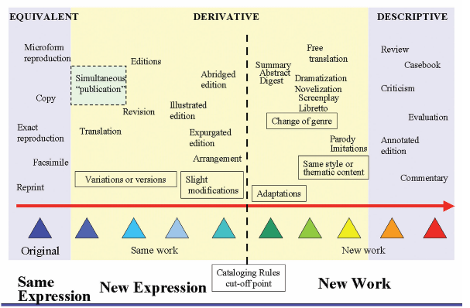
Tillett: Bibliographic Relationships

Slide 3
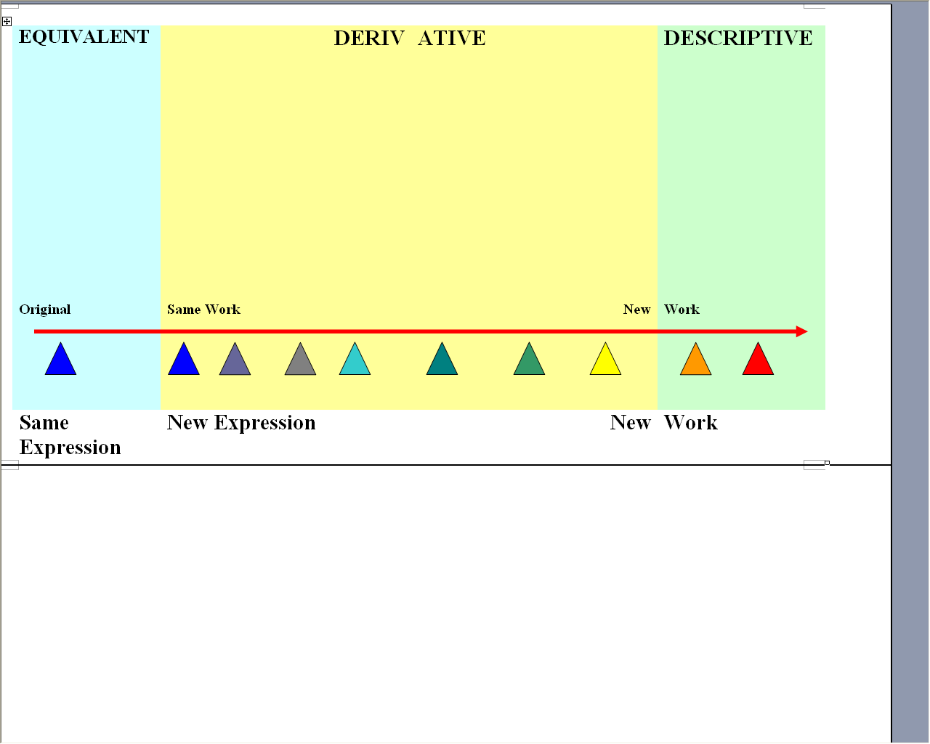
Pin the tail

Slide 4
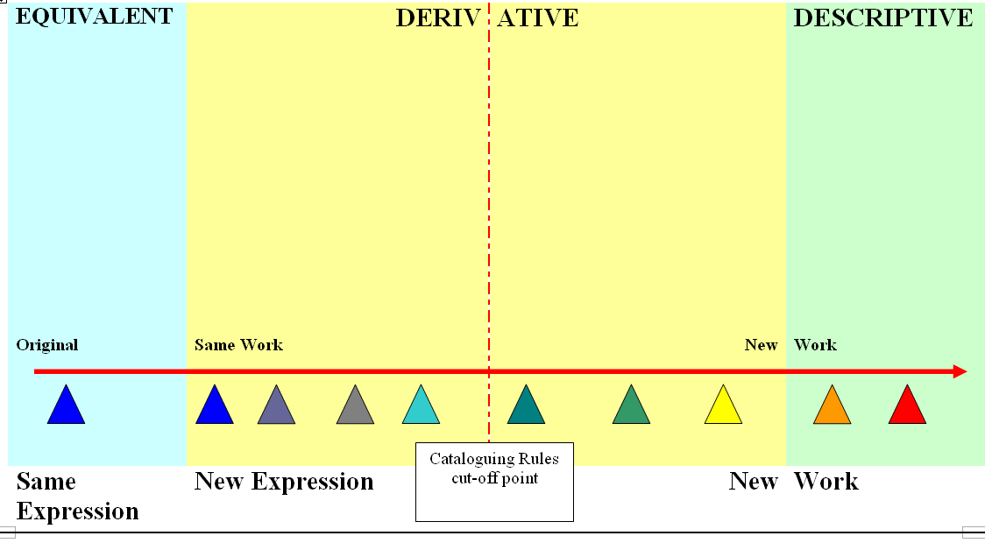
Tillett: Bibliographic Relationships

